Slide 1

INTERNET OF THINGS
Introduction
Dr. Nagegowda K S
Department of Computer Science
& Engineering

Slide 2

INTERNET OF THINGS
Introduction
Dr. Nagegowda K S
Department of Computer Science & Engineering

Slide 5
Agenda
INTERNET OF THINGS
Introduction
Domain Specific IoTs
IoT Business Opportunities
IoT Start-Ups in India

Slide 6
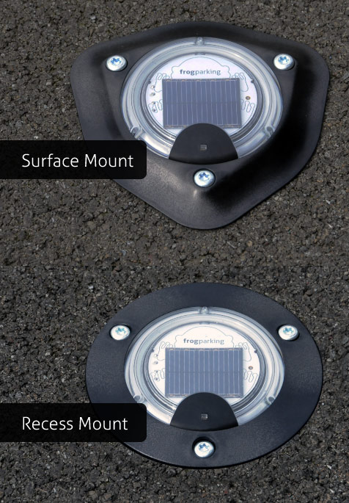
Domain Specific IoTs
INTERNET OF THINGS
Introduction
Home/Building Automation
Smart Lighting – about 20% of the energy use in the world is for lighting
Automatic adaptation based on ambient conditions
Occupancy sensors
Smart Appliances – remote control
Intrusion Detection - alerts
Cities
Smart Parking - https://www.youtube.com/watch?v=UdAA2danoLY
Smart Lighting
Smart Roads
Structural Health Monitoring

Slide 7
Domain Specific IoTs
INTERNET OF THINGS
Introduction
Environment
Weather Monitoring
http://tawn.tnau.ac.in/
Air/Noise Pollution Monitoring
Energy
Smart Grids
Power transmission, distribution, consumption
India – IoT startup example
Smart Meters
Record Energy Consumption
http://www.monitormymeter.com/smart-metering.html

Slide 8
Domain Specific IoTs
INTERNET OF THINGS
Introduction
Retail
Inventory Management – RFID
Smart Payments using NFC (Near Field Communication) (range of 10 cm)
Logistics
Fleet Tracking using GPS
Shipment Monitoring
Remote Vehicle Diagnostics
Agriculture
Smart Irrigation
Greenhouse Control

Slide 9
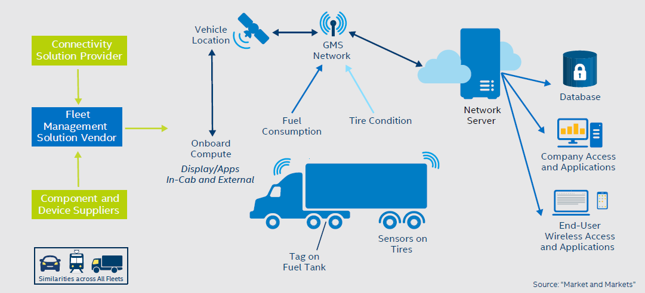
Fleet Management
INTERNET OF THINGS
Introduction

Slide 10
Domain Specific IoTs
INTERNET OF THINGS
Introduction
Industry
Machine Utilization/Diagnosis
Indoor Air Quality Monitoring
Edge Computing
Health and Lifestyle
Health and Fitness Monitoring
Wearable IoT devices to monitor body temperature,
heart rate, BP, oxygen level etc
https://www.fitbit.com/in/flex
Wearable Electronics
Smartwatch - https://www.wareable.com/smartwatches

Slide 11
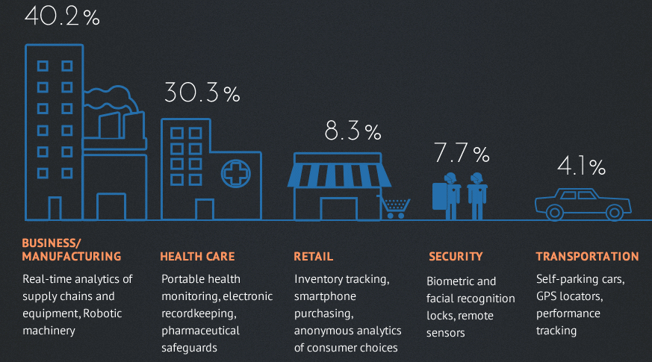
IoT Deployment
INTERNET OF THINGS
Introduction

Slide 12
IoT Business Opportunities
INTERNET OF THINGS
Introduction
Market Segmentation
Horizontal
Vertical
Offerings
Products
Services
Solutions
Company Types
Existing
Large multinationals (IBM, GE, Honeywell, Samsung)
Start-ups

Slide 13
India Business Opportunities
INTERNET OF THINGS
Introduction
Infrastructure
Sensors, Physical Devices & Controllers
High volume, many players, low margins
Gaps – security
Platform
Many cloud services available
Applications
Most promising
Value from data is customer specific
High returns

Slide 14
IoT Startups in India
INTERNET OF THINGS
Introduction
Altizon - http://altizon.com/
Axelta- http://www.axelta.com/
CarIQ - https://mycariq.com/
Entrib - http://www.entrib.com/
LifePlot - http://lifeplot.in/index.html
Oakter - http://oakter.com/
SenseGiz - http://instore.sensegiz.com/
Vahanalytics - http://www.vahanalytics.com/#/

Slide 15
Altizon
INTERNET OF THINGS
Introduction
Founded in April 2013
Funded by Wipro Ventures and others
Industrial Internet Platform
Product
Datonis IoT Platform
Used for Condition Monitoring, Predictive Analytics, Operations, driving Consumer Insights
Case Studies
Energy Management
Monitoring Power Availability and Quality across India

Slide 16
Altizon Case Study
INTERNET OF THINGS
Introduction
Energy Management – Monitoring Power Availability and Quality across India
Customer – Prayas Energy Group
http://www.prayaspune.org/peg/
Solution
Electricity Supply Monitoring Initiative (ESMI)
Monitor power quality (voltage) and availability (power interrupts) in hundreds of villages and small towns across India

Slide 17
Altizon Case Study
INTERNET OF THINGS
Introduction
Low cost, rugged energy monitoring appliance to sample power quality and transmit data to cloud via 2G/3G networks
Sample data every minute
http://articles.economictimes.indiatimes.com/2015-03-31/news/60682465_1_devices-data-prayas-energy-group

Slide 18
Technology
INTERNET OF THINGS
Introduction
Aliot Smart Grid Appliance
Works like an electricity meter and can be installed at remote locations
Has SIM card slot compatible with all service providers in India
Cost Rs 9,000
Datonis platform in SaaS mode
Customer given account and API to build portal
http://watchyourpower.org/
How it works
Check out site for
Sample Data, Sample Summary Analysis Report, APIs

Slide 19
Trends
INTERNET OF THINGS
Introduction
Smart Cities
http://smartcities.gov.in
Objectives
Revenue generation
Cost reduction
Segments
Industrial IoT – e.g. Healthcare
Cosumer IoT – e.g. Wearables
Edge Computing
Low Power Networks

Slide 20
Summary
INTERNET OF THINGS
Introduction
Important to understand trends in
Technology
Technology stack
Industry
IoT enabled products
http://www.iotenableddevices.com/
Business
An App for every type of device?
https://google.github.io/physical-web/
Employment Opportunities

Slide 21
THANK YOU
Dr. Nagegowda K S
Department of Computer Science & Engineering
nagegowda@pes.edu

